Slide 1


RUDRA PATEL
June, 2025
© Rudra - IBM Capstone 2025

Slide 2

Outline
Executive Summary
Introduction
Methodology
Results
Conclusion
Appendix
© Rudra - IBM Capstone 2025

Slide 3
Executive Summary
Objective: Identify key factors that influence the success or failure of Falcon 9 missions.
Data Sources: Collected using the SpaceX REST API and web scraping from Wikipedia.
Data Processing: Cleaned, merged, and transformed using Pandas and NumPy.
Exploratory Data Analysis (EDA): Conducted using Matplotlib, Seaborn, and SQL queries to uncover trends and correlations.
Interactive Visualizations: Built using Folium (maps) and Plotly Dash (dashboards) for dynamic data exploration.
Predictive Modeling: Trained and evaluated classification models (e.g., Logistic Regression, SVM, Decision Tree) to predict launch outcomes.
© Rudra - IBM Capstone 2025

Slide 4
Introduction
Project Background SpaceX is a private aerospace company that has conducted numerous Falcon 9 rocket launches. Each mission involves high costs and varying outcomes depending on launch site, payload, booster version, and other conditions.
Problem Statement This project aims to answer key business and engineering questions:
What are the most reliable launch sites?
How does payload affect launch success?
Can we predict mission outcomes using historical data?
Objective To apply the full data science workflow — from data collection and cleaning to EDA, visualization, and machine learning — to derive actionable insights and build a predictive model for launch outcomes.
© Rudra - IBM Capstone 2025

Slide 5

Section 1
© Rudra - IBM Capstone 2025

Slide 6
Methodology
Executive Summary
Data collection methodology:
Collected SpaceX Falcon 9 mission data using two sources:
SpaceX REST API for JSON-based mission details (e.g., payload, orbit, booster)
Web scraping from Wikipedia for historical mission records and launch outcome annotations
Perform data wrangling
Merged and cleaned datasets using Pandas. Standardized column names and types, filtered Falcon 9 records, filled missing values, and created engineered features like year and binary success outcome.
Perform exploratory data analysis (EDA) using visualization and SQL
Perform interactive visual analytics using Folium and Plotly Dash
Perform predictive analysis using classification models
Built supervised ML models to predict mission outcomes.
© Rudra - IBM Capstone 2025

Slide 7
Data Collection
Two primary data sources were used:
SpaceX Launch Data API
Used Python’s requests library to make REST API calls
Retrieved structured JSON data with mission details (flight number, payload mass, site, orbit, success status)
Data was normalized using json_normalize() and stored in a DataFrame
Web Scraping (Wikipedia)
Used requests and BeautifulSoup to extract HTML tables from Falcon 9 launch records
Parsed launch dates, outcomes, sites, and booster info
Cleaned and converted scraped tables to structured CSV/DF format
© Rudra - IBM Capstone 2025

Slide 8
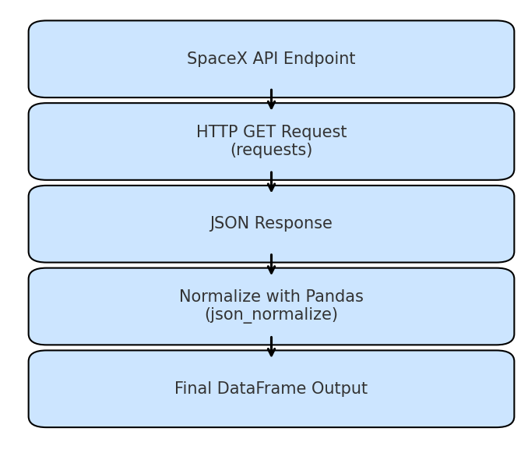
Data Collection – SpaceX API
Used Python’s requests library to query the SpaceX Launches API(https://api.spacexdata.com/v4/launches)
Fetched structured JSON data on:
→ Flight number → Payload mass
→ Launch site → Booster version→ Launch outcome (success/failure)
Parsed and flattened nested JSON using json_normalize
Created Pandas DataFrame for analysis
https://github.com/Rudra-365/IBM_Capstone_RP/blob/main/jupyter-labs-spacex-data-collection-api.ipynb

Slide 9
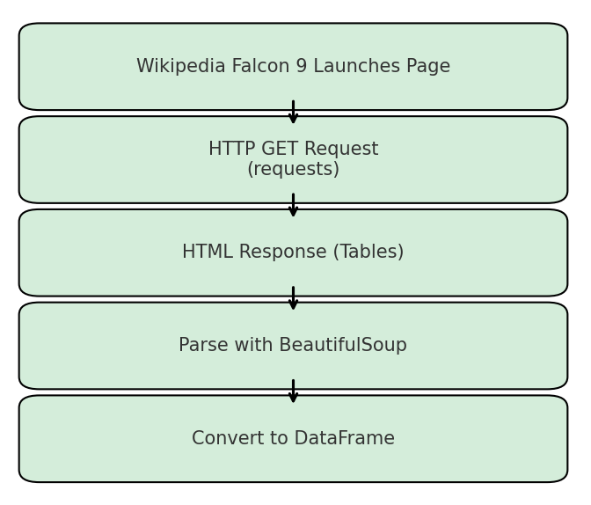
Data Collection - Scraping
Target source: Wikipedia Falcon 9 launch records page
Used requests to fetch HTML content
Parsed HTML tables using Beautiful Soup
Extracted relevant columns: launch date, site, booster version, outcome
Converted parsed tables to Pandas DataFrame for merging and cleaning
Place your flowchart of web scraping here
https://github.com/Rudra-365/IBM_Capstone_RP/blob/main/jupyter-labs-webscraping.ipynb
© Rudra - IBM Capstone 2025

Slide 10
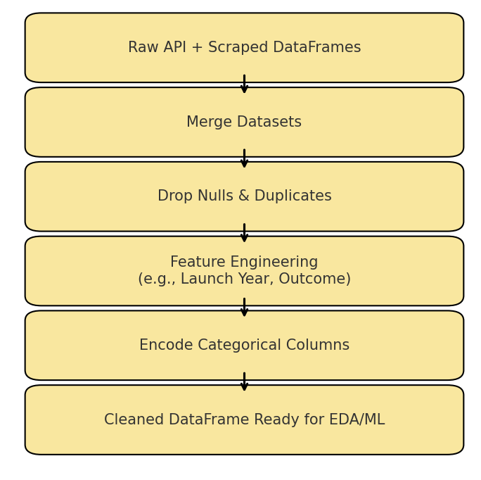
Data Wrangling
Merged API and scraped datasets using pandas.merge()
Dropped duplicate and null entries.
Standardized column names and converted date formats.
Engineered new features:→ Launch Year (from date)→ Launch Outcome (binary)→ Booster Version Category.
Encoded categorical features for modeling using one-hot encoding
https://github.com/Rudra-365/IBM_Capstone_RP/blob/main/labs-jupyter-spacex-Data%20wrangling.ipynb
© Rudra - IBM Capstone 2025

Slide 11
EDA with Data Visualization
Charts and Visualizations Used
Flight Number vs Launch Site (Scatter Plot): → To identify launch success trends over time by location.
Payload Mass vs Orbit (Scatter Plot): → To analyze how different orbit types are associated with payload size and outcome.
Orbit Type vs Success Rate (Bar Chart): → To assess which orbits are more likely to succeed.
Flight Number vs Orbit (Scatter Plot): → To observe whether orbit preferences changed over time.
Yearly Launch Success Trend (Line Chart): → To understand how launch reliability improved over the years.
https://github.com/Rudra-365/IBM_Capstone_RP/blob/main/edadataviz.ipynb
© Rudra - IBM Capstone 2025

Slide 12
EDA with SQL
Retrieved all unique launch site names.
Filtered launch sites beginning with 'CCA’.
Calculated total payload mass from NASA missions.
Found average payload mass by booster version 'F9 v1.1’.
Identified the first successful landing on a ground pad.
Listed boosters that successfully landed on a drone ship with payload between 4000 and 6000 kg.
Counted total number of mission outcomes (Success vs Failure).
Identified the booster that carried the maximum payload.
Listed failed landings on drone ships during 2015 by site and version.
Ranked landing outcomes by frequency for missions between 2010-06-04 and 2017-03-20.
https://github.com/Rudra-365/IBM_Capstone_RP/blob/main/jupyter-labs-eda-sql-coursera_sqllite.ipynb

Slide 13
Build an Interactive Map with Folium
Map Elements Used
Markers: Added for each launch site to show geographic positions on the global map.
Circle Markers: Used to color-code and visually distinguish launch outcomes (e.g., green = success, red = failure).
Distance Lines: Added polylines to visualize distances from launch sites to nearest coastlines, railways, and highways.
Popups and Tooltips: Enhanced user interaction by showing launch site details on click.
Why These Objects Were Used
To analyze spatial distribution of SpaceX launch infrastructure.
To identify proximity to infrastructure that could impact mission logistics.
To create an intuitive, interactive way to explore location-specific success trends.
© Rudra - IBM Capstone 2025

Slide 14
Build a Dashboard with Plotly Dash
Plots and Interactions Implemented
Pie Chart:→ Shows proportion of successful launches by site.
Bar Chart:→ Displays launch success/failure counts per site.
Scatter Plot:→ Plots Payload Mass (kg) vs. Launch Outcome, filtered by orbit type.
Dropdown Menu:→ Allows selection of individual launch sites for targeted analysis.
Slider Component:→ Filters missions by payload mass range.
Why These Features Were Used
To allow users to dynamically explore success rates across launch sites.
To compare performance over payload ranges and orbit types.
To build an interactive tool for both technical and non-technical stakeholders
© Rudra - IBM Capstone 2025

Slide 15
Predictive Analysis (Classification)
Model Development Process
Selected relevant features: Launch Site, Payload Mass, Booster Version Category, and Orbit.
Applied one-hot encoding to categorical features
Split data into training and test sets (80/20)
Trained multiple classifiers:→ Logistic Regression→ Support Vector Machine (SVM)→ Decision Tree→ K-Nearest Neighbors (KNN)
Evaluated models using:→ Accuracy→ Precision & Recall→ Confusion Matrix
Best Model: SVM had the best balance of accuracy and generalization on unseen data.
https://github.com/Rudra-365/IBM_Capstone_RP/blob/main/SpaceX_Machine%20Learning%20Prediction_Part_5.ipynb
© Rudra - IBM Capstone 2025

Slide 16
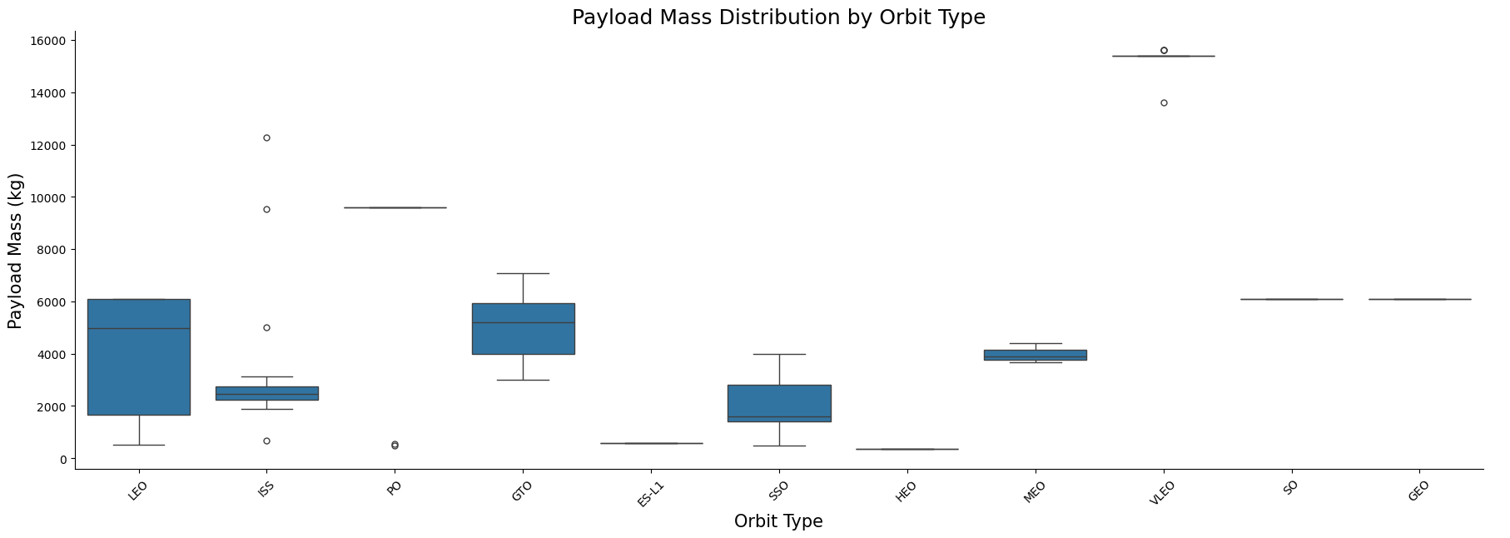
Results
Exploratory data analysis results:
Key Finding: CCAFS LC-40 had the most launches but variable success rate.
Insight: Launch success increases with flight number and optimized orbit selection.
Example Charts:
→ Payload Mass vs Orbit

Slide 17
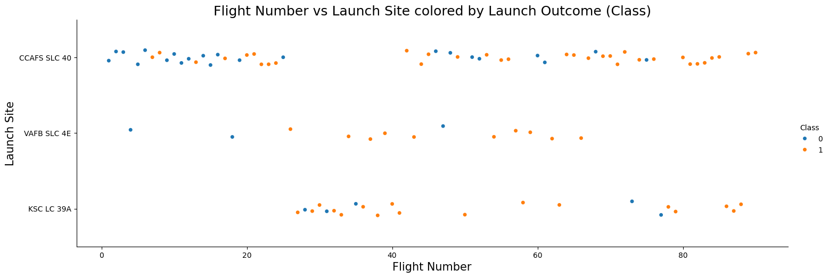
Results
→ Flight Number vs Launch Site

Slide 18
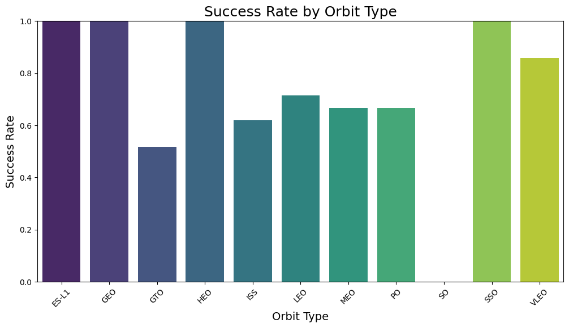
Results
→ Success Rate by Orbit

Slide 19

Results
Predictive analysis results

Slide 20

Section 2
© Rudra - IBM Capstone 2025

Slide 21
Flight Number vs. Launch Site
Observations
Most missions were launched from CCAFS LC-40 and KSC LC-39A
Early flights (lower flight numbers) had mixed outcomes across sites
Later missions became more concentrated and successful from specific sites like KSC LC-39A

Slide 22
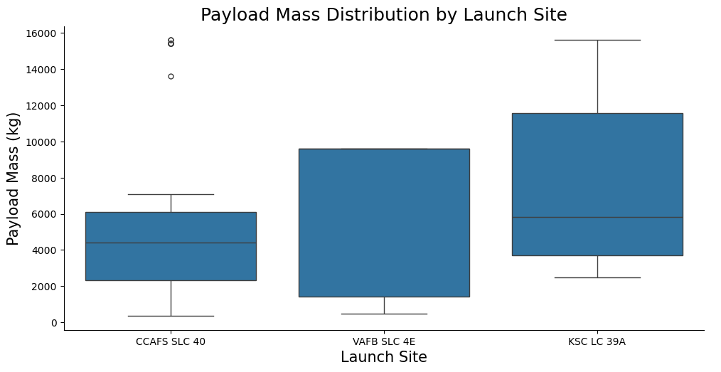
Payload vs. Launch Site
Observations
KSC LC-39A and VAFB SLC-4E handled higher payloads than others
Successful launches (green dots) tend to cluster within 2000–6000 kg range
Launch failures (red dots) were more common at lower payloads

Slide 23
Success Rate vs. Orbit Type

Slide 24
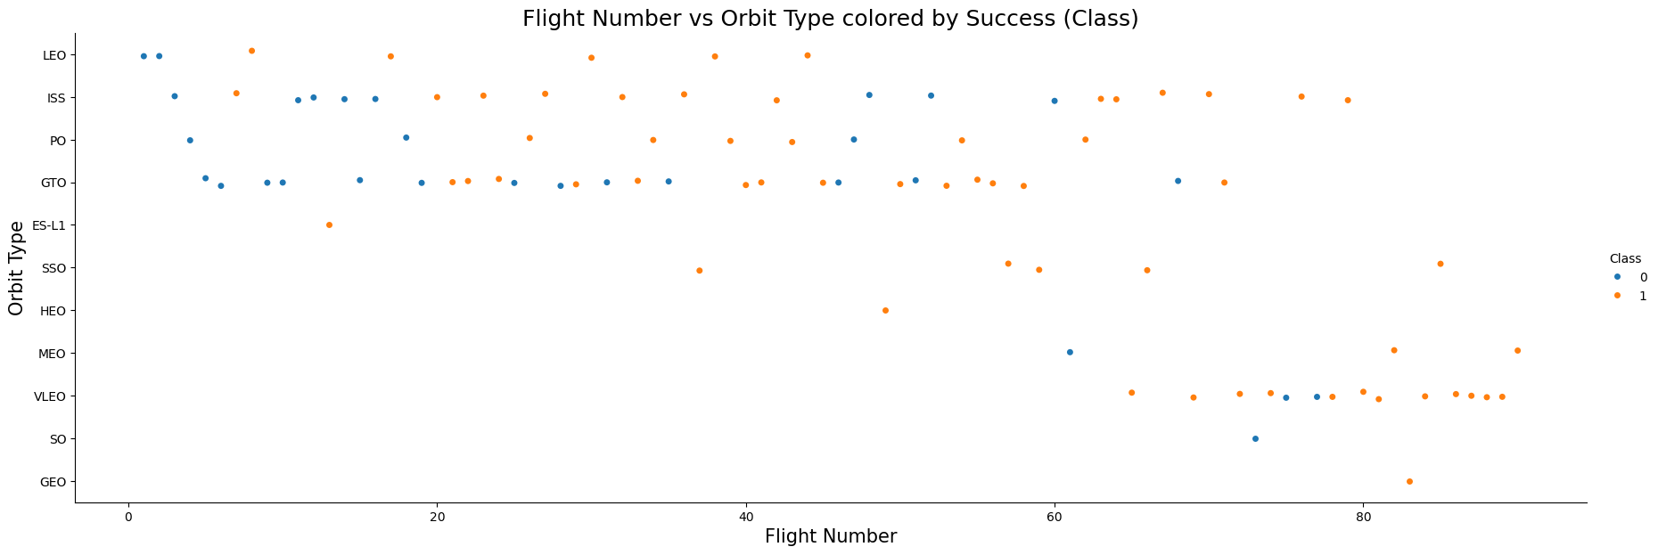
Flight Number vs. Orbit Type
Observations
Earlier missions targeted LEO (Low Earth Orbit) more frequently
Gradually expanded to GTO, SSO, and other orbits
Each orbit type shows varied success distribution based on mission complexity
© Rudra - IBM Capstone 2025

Slide 25
Payload vs. Orbit Type
Observations
Orbits like LEO, SSO, and PO generally involve lighter payloads
GTO missions handle some of the heaviest payloads
Green (successful) missions tend to dominate across all orbits, though failures are more frequent in early flights and at low payload levels
© Rudra - IBM Capstone 2025

Slide 26
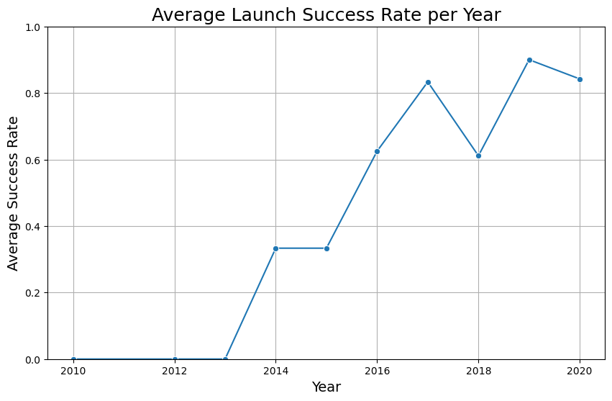
Launch Success Yearly Trend
Observations
Success rate steadily increased from 2010 to 2020
Early years show more variability due to experimentation and R&D launches
By 2017 onward, success rates plateaued near or at 100%, showing mission maturity
© Rudra - IBM Capstone 2025

Slide 27
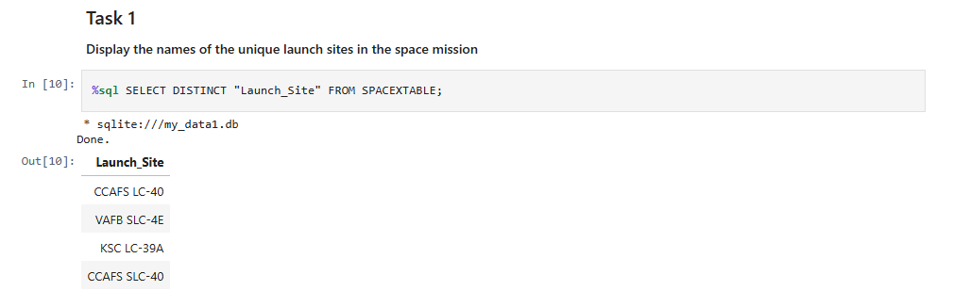
All Launch Site Names
Explanation:
- Displaying the names of the unique launch sites in the space mission.
© Rudra - IBM Capstone 2025

Slide 28
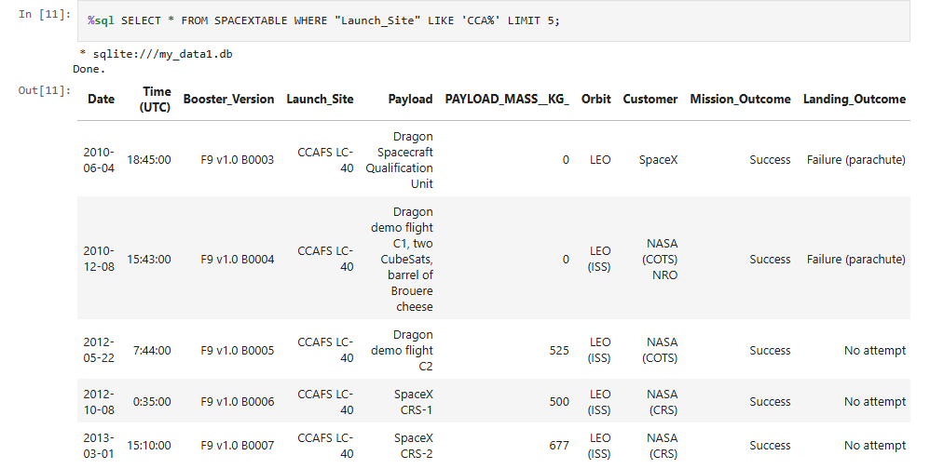
Launch Site Names Begin with 'CCA'
Explanation:
- Displaying 5 records where launch sites begin with the string ‘’CCA.
© Rudra - IBM Capstone 2025

Slide 29
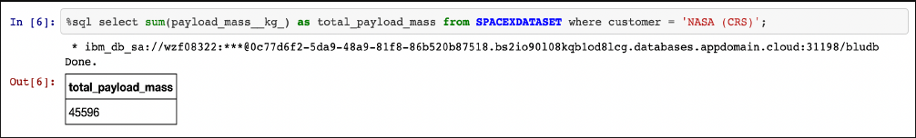
Total Payload Mass
Explnation:
- Displaying the total payload mass carried by boosters launched by NASA (CRS).
© Rudra - IBM Capstone 2025

Slide 30
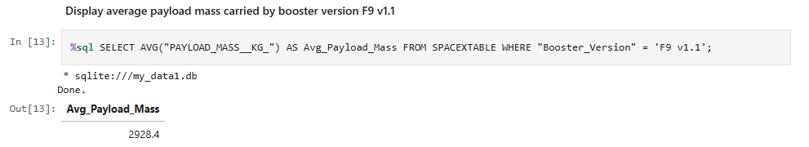
Average Payload Mass by F9 v1.1
Explanation:
- Displaying average payload mass carried by booster version F9 v1.1
© Rudra - IBM Capstone 2025

Slide 31
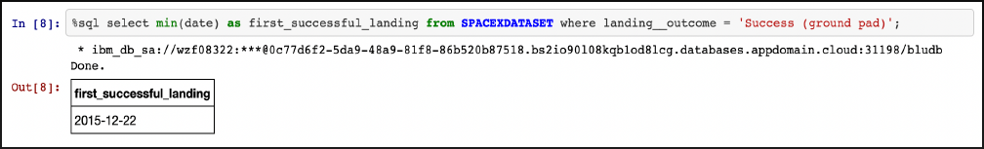
First Successful Ground Landing Date
Explanation:
- Listing date when the first successful landing outcome in ground pad was achieved.
© Rudra - IBM Capstone 2025

Slide 32
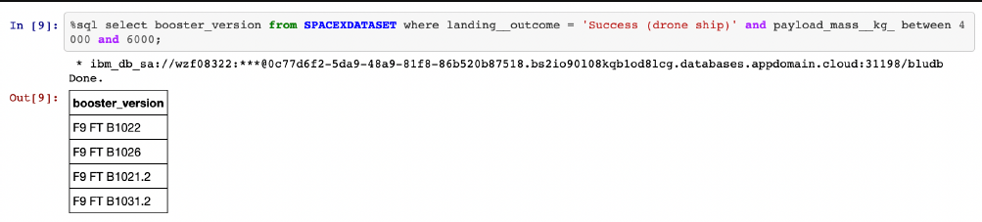
Successful Drone Ship Landing with Payload between 4000 and 6000
Explanation:
- Listing the names of the boosters which have success in drone ship and have payload mass greater than 4000 but less than 6000.
© Rudra - IBM Capstone 2025

Slide 33
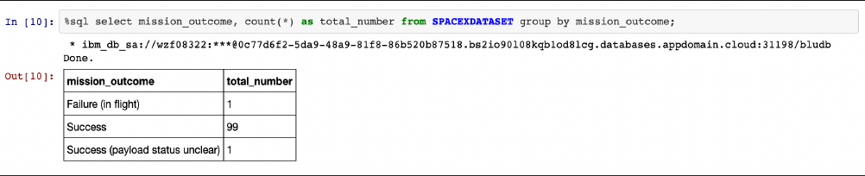
Total Number of Successful and Failure Mission Outcomes
Explanation:
- Listing the total number of successful and failure mission outcomes.
© Rudra - IBM Capstone 2025

Slide 34
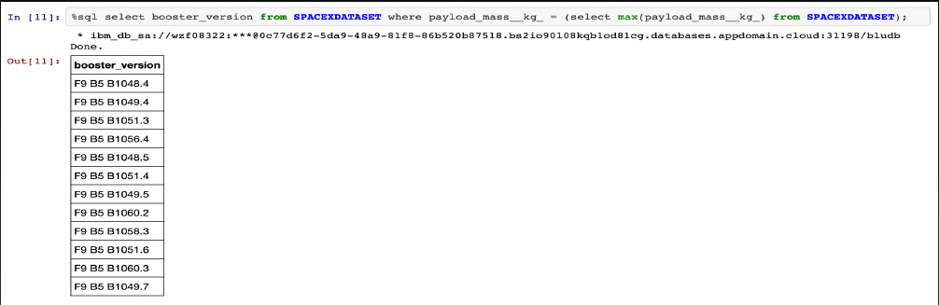
Boosters Carried Maximum Payload
Explanation:
- Listing the names of the booster versions which have carried the maximum payload mass.
© Rudra - IBM Capstone 2025

Slide 35
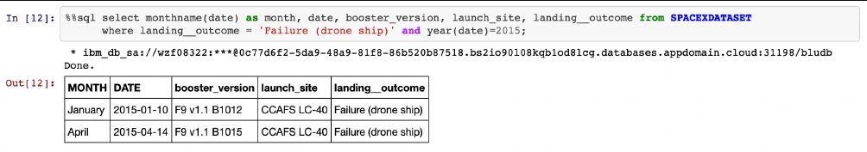
2015 Launch Records
Explanation:
- Listing the failed landing outcomes in drones ship, their booster versions and launch site names for the months in years 2015.
© Rudra - IBM Capstone 2025

Slide 36
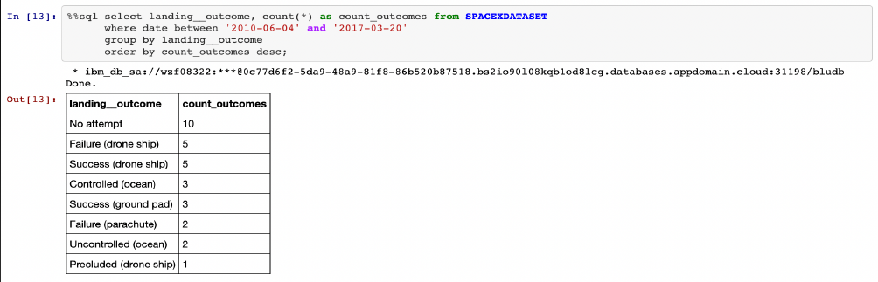
Rank Landing Outcomes Between 2010-06-04 and 2017-03-20
Explanation:
- Ranking the count of landing outcomes (such as failure (drone ship) or success (ground pad) ) between the date 2010-06-04 and 2017-03-02 in descending order.
© Rudra - IBM Capstone 2025

Slide 37

Section 3
© Rudra - IBM Capstone 2025

Slide 38
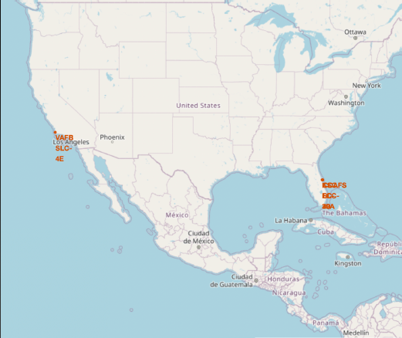
All launch sites’ location markers on a global map
Explanation:
• Most of Launch sites are in proximity to the Equator line. The land is moving faster at the equator than any other place on the surface of the Earth. Anything on the surface of the Earth at the equator is already moving at 1670 km/hour. If a ship is launched from the equator it goes up into space, and it is also moving around the Earth at the same speed it was moving before launching. This is because of inertia. This speed will help the spacecraft keep up a good enough speed to stay in orbit.
• All launch sites are in very close proximity to the coast, while launching rockets towards the ocean it minimises the risk of having any debris dropping or exploding near people.
© Rudra - IBM Capstone 2025

Slide 39
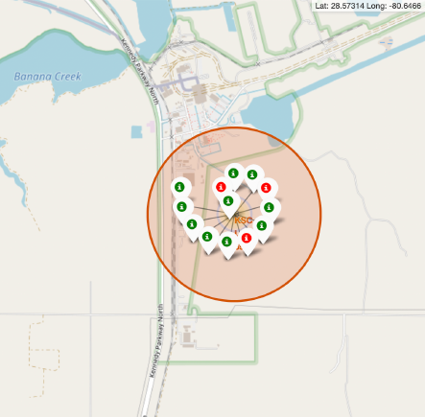
Colour-labeled launch records on the map
Explanation:
• From the colour-labeled markers we should be able to easily identify which launch sites have relatively high success rates.
- Green Markers = Successful Launch
- Red Markers = Failed Launch
• Launch Site KSC LC-39A has a very high Success Rate.
© Rudra - IBM Capstone 2025

Slide 40
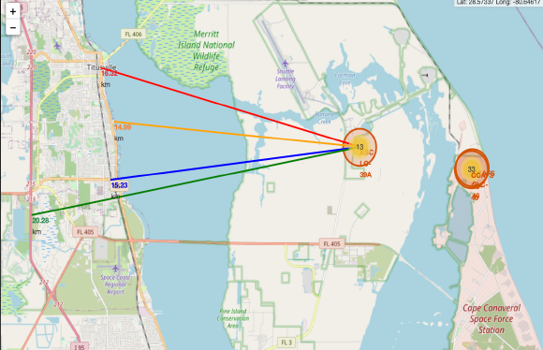
Distance from the launch site KSC LC-39A to its proximities
Explanation:
• From the visual analysis of the launch site KSC LC-39A we can clearly see that it is:
- relative close to railway (15.23 km)
- relative close to highway (20.28 km)
- relative close to coastline (14.99 km)
• Also the launch site KSC LC-39A is relative close to its closest city Titusville (16.32 km).
Failed rocket with its high speed can cover distances like 15-20 km in few seconds. It could be potentially dangerous to populated areas.
© Rudra - IBM Capstone 2025

Slide 41

Section 4
© Rudra - IBM Capstone 2025

Slide 42
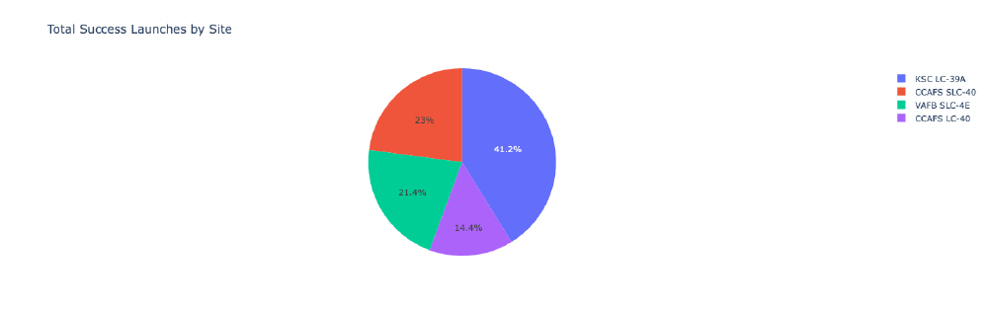
Launch success count for all sites
Explanation:
- The chart clearly shows that from all the sites, KSC LC-39A has the most successful launches
© Rudra - IBM Capstone 2025
Notes:
The

Slide 43
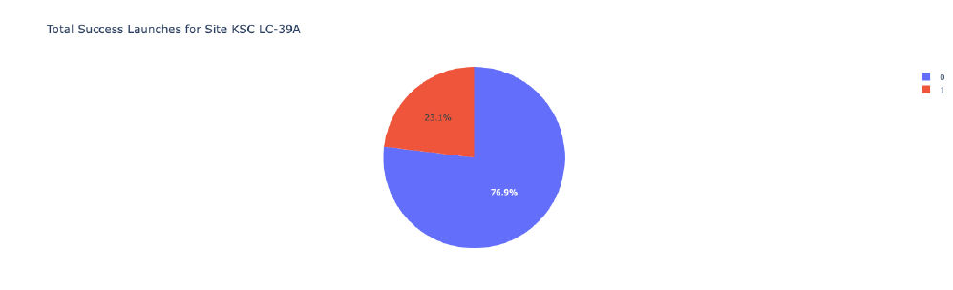
Launch site with highest launch success ratio
Explanation:
- KSC LC-39A has the highest launch success rate (76.9%) with 10 successful and only 3 failed landings.
© Rudra - IBM Capstone 2025

Slide 44
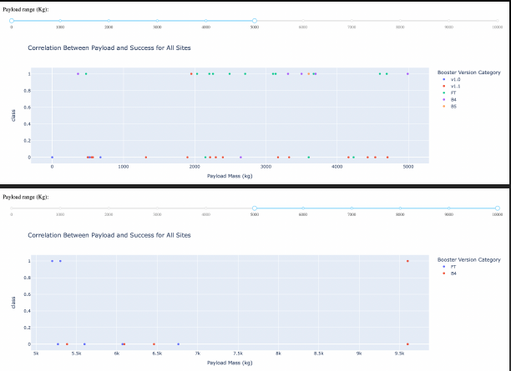
Payload Mass vs. Launch Outcome for all sites
Explanation:
The charts show that payloads between 2000 and 5500 kg have the highest success rate.
© Rudra - IBM Capstone 2025

Slide 45

Section 5
© Rudra - IBM Capstone 2025

Slide 46
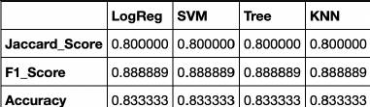
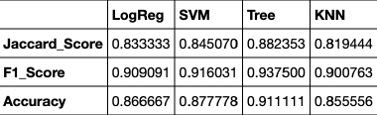
Classification Accuracy
Based on the scores of the Test Set, we can not confirm which method performs best.
Same Test Set scores may be due to the small test sample size (18 samples). Therefore, we tested all methods based on the whole Dataset.
The scores of the whole Dataset confirm that the best model is the Decision Tree Model. This model has not only higher scores, but also the highest accuracy.
Scores and Accuracy of the Test Set
Scores and Accuracy of the Entire Data Set
© Rudra - IBM Capstone 2025

Slide 47
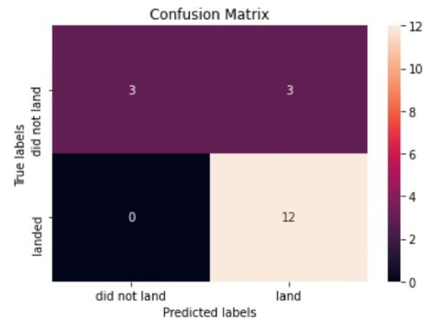
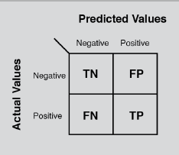
Confusion Matrix
Explanation:
Examining the confusion matrix, we see that logistic regression can distinguish between the different classes. We see that the major problem is false positives.
© Rudra - IBM Capstone 2025

Slide 48
Conclusions
Decision Tree Model is the best algorithm for this dataset.
Launches with a low payload mass show better results than launches with a larger payload mass.
Most of launch sites are in proximity to the Equator line and all the sites are in very close proximity to the coast.
The success rate of launches increases over the years.
KSC LC-39A has the highest success rate of the launches from all the sites.
Orbits ES-L1, GEO, HEO and SSO have 100% success rate.
© Rudra - IBM Capstone 2025

Slide 49
Appendix
Include any relevant assets like Python code snippets, SQL queries, charts, Notebook outputs, or data sets that you may have created during this project
© Rudra - IBM Capstone 2025

Slide 50

© Rudra - IBM Capstone 2025

